Slide 1
Introduction to eSight 21.0 Installation, Deployment, and Commissioning

Slide 2
This course describes how to deploy, install, and commission eSight.

Slide 3
Upon completion of this course, you will be able to:
Be familiar with eSight single-node, two-node cluster and multi-node cluster deployment solutions.
Be familiar with eSight pre-installation and new installation scenarios.
Know how to install, plan, and configure eSight.
Know how to configure eSight after the installation.

Slide 4
1
eSight Deployment Solutions and Scenarios
2
eSight Installation and Commissioning
3
eSight O&M

Slide 5
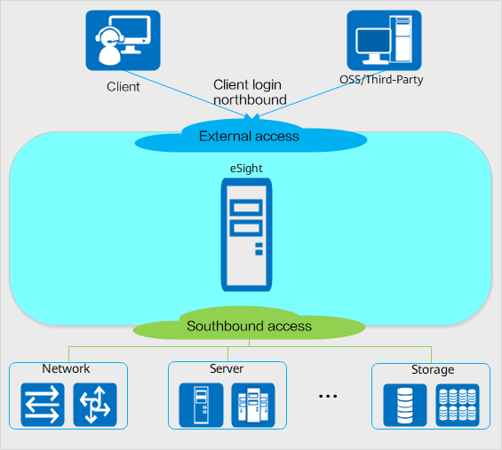
eSight Deployment Solution: Single-Node System
The eSight single-node system deployment solution is applicable to scenarios that do not require high reliability.
B/S mode: In the single-node system deployment scheme, multiple web clients and one eSight server are connected through a local area network (LAN) or wide area network (WAN).
Network isolation:
Single-plane deployment: External access, internal interaction, and southbound device management functions of eSight are deployed on the same network plane.
Dual-plane deployment: The external access network, internal communication network, and southbound access network are deployed on two network planes. It is recommended that the internal communication network and southbound access network be deployed on the same network plane and the external access network be deployed on the other network plane.

Slide 6
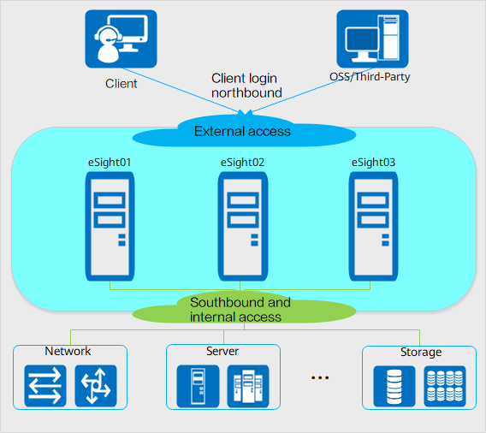
eSight Deployment Solution: Multi-node Cluster
In the multi-node cluster deployment mode, all eSight functions are deployed on multiple servers or VMs. Each server or VM is a node. Currently, the three-node cluster deployment scheme is supported.
This mode is applicable to scenarios where the network scale is large and the reliability requirement is high.
Network isolation
Single-plane deployment: External access, internal interaction, and southbound device management functions of eSight are deployed on the same network plane.
Dual-plane deployment: The external access network, internal communication network, and southbound access network are deployed on two network planes. It is recommended that the internal communication network and southbound access network be deployed on the same network plane and the external access network be deployed on the other network plane.
Cluster reliability mechanism
Microservices are deployed in multi-instance and multi-active mode. Service loads are evenly distributed among multiple nodes.
The database uses the instance-level active/standby replication mode.
Node | Type
eSight01 | Cluster node (active management node+application service)
eSight02 | Cluster node (standby management node+application service)
eSight03 | Cluster node (application service)

Slide 7
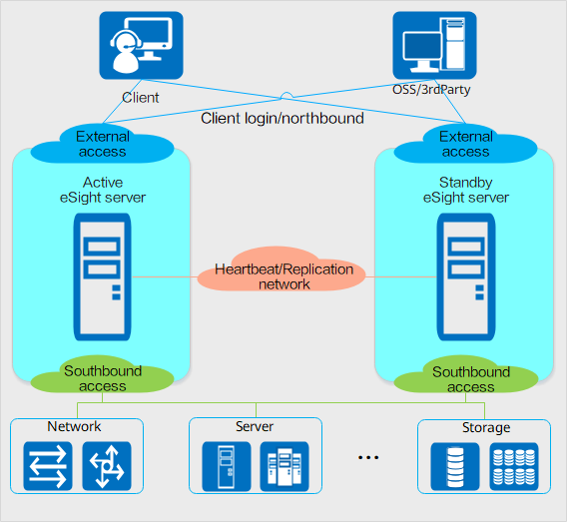
eSight Deployment Solution: Two-Node Cluster
An eSight two-node cluster has one active server and one standby server. eSight is installed separately on both the active and standby servers. Data between the active and standby servers is synchronized through a dedicated replication line. If the active server is faulty, services are automatically switched to the standby server to ensure proper running of the eSight system.
Network isolation
Single-plane deployment: External access, internal interaction, and southbound device management functions of eSight are deployed on the same network plane.
Three-plane deployment: The external access network, southbound access network, and heartbeat/repetition network are deployed on three network planes.
Two-node cluster reliability mechanism
Both the active and standby eSight servers are deployed in single-node system mode. If the active server is faulty, services are automatically switched to the standby server.
Files and databases between the active and standby servers are synchronized through the heartbeat/replication network.

Slide 8
Typical Scenarios: Preinstallation
Hardware connection
Powering on devices
Configuring the eSight IP address
Starting eSight
Configuring periodic backup
(Optional) Configuring NTP
(Optional) Reconstructing network planes
Hardware installation
System configuration
eSight
configuration
Incrementally Installing Service Components
Loading licenses
Commissioning eSight
Time and time zone
Host name
Routing
Collecting the ESN
Applying for licenses
Importing licenses
Huawei provides a complete set of hardware and software in preinstallation scenarios. The operating system, database, and basic eSight software have been installed before delivery.
After the hardware is installed, you only need to configure the network, operating system, and eSight.

Slide 9
Typical Scenarios: New Installation
Hardware connection
Powering on devices
Time and time zone
Host name
Routing
Configuring the eSight IP address
Starting eSight
Configuring periodic backup
(Optional) Configuring NTP
(Optional) Reconstructing network planes
Hardware installation
System
installation
System configuration
eSight
installation
eSight configuration
Loading licenses
Commissioning eSight
Configuring RAID for hard disks
Installing the Operating system
(Optional) Binding NICs
Installing eSight
Collecting the ESN
Applying for licenses
Importing licenses
In this scenario, you have purchased a new server, operating system, and database, and the server meets eSight software and hardware requirements.
After the hardware is installed, you need to install and configure the operating system, configure the network, install and configure eSight, and commission eSight.

Slide 10
Typical Scenarios: Routine Maintenance
Check the CPU usage.
Check the memory usage.
Check the system partition status.
Check the microservice running status.
Check the database running status.
System status
Service status
Backup and restoration
Security configuration
Periodically change the eSight login password.
Periodically change the operating system password.
Periodically change the database password.
Check backup data.
Check the backup server status.
To ensure the stable running of eSight, you need to routinely check the eSight status and maintain eSight.

Slide 11
1
eSight Deployment Solutions and Scenarios
2
eSight Installation and Commissioning
3
eSight O&M

Slide 12
Installation and Deployment Process
Preinstallation Scenario | New Installation
Installation planning | Installation planning
 | Software preparation
 | RAID configuration
 | Operating system installation
Operating system configuration | Operating system configuration
 | eSight installation
eSight configuration | eSight configuration
Incrementally Installing Service Components | (Optional) Incrementally Installing Service Components
License import | License import

Slide 13
Installation Planning - Network/IP Address/Network Port Binding
Node | IP Address Type | Function | IP Address Example | Network Port
eSight node | Logging in using the client Northbound/southbound/internal communication IP address | The information is used to connect to the eSight client, eSight node, upper-level OSS, and southbound network. | IP address: 192.168.1.101 Mask: 24 | bond0 (eth0 and eth4)
Single-plane
deployment
Node | IP Address Type | Function | IP Address Example | Network Port
eSight node | Client login/northbound/server access | The information is used to connect to the eSight client, eSight node, and upper-level OSS. | IP address: 192.168.1.101 Mask: 24 | bond0 (eth0 and eth4)
 | Southbound/internal communication IP addresses | Used for communication between southbound devices and internal services. | IP address: 192.168.2.101 Mask: 24 | bond1 (eth1 and eth5)
Dual-plane
deployment

Slide 14
Installation Planning - Disk RAID and Partition
RAID solution description:
Operating system partition description:
Disk Quantity | RAID Solution
2 | Use two disks to configure RAID1.
3 | Use three disks to configure RAID5.
4 | Use the first two disks to configure RAID1. Use the remaining two disks to configure another RAID1.
5 | Use the first two disks to configure RAID1. Use the remaining three disks to configure RAID5.
6 | Use the first two disks to configure RAID1. Use the remaining four disks to configure RAID10.
8 | Use the first three disks to configure RAID5. Use the remaining five disks to configure RAID5.
Mount Point | Partition Size (GB) | File System | Partition Type | Description
/ | 20 | Ext4 | Primary | Root directory for installing the operating system
/boot | 1 | Ext4 | Primary | Boot partition
/swap | 16 | Swap | Primary | Swap partition
/home | 1 | ext4 | Logical | Stores the local user data.
/tmp | 10 | ext4 | Logical | Stores temporary files.
/var | 5 | ext4 | Logical | Stores dynamic data about the daemon process and other system service processes.
/var/log | 20 | ext4 | Logical | Stores system logs.
/var/log/audit | 2 | ext4 | Logical | Stores audit log data.
/user | 5 | ext4 | Logical | Stores user data.
/var/tmp | 5 | ext4 | Logical | Stores temporary files.
/opt | Remaining space | ext4 | Logical | Used to install eSight. The partition size equals all remaining disk space.
The following tables recommend reliable, efficient RAID solutions based on the number of hard disks.
The RAID solution featuring both reliability and efficiency is recommended.

Slide 15
Software Preparation
x86 Server | TaiShan Server | Description
eSight_21.0.0_EulerOSV2R9-x86-64.iso | eSight_21.0.0_EulerOSV2R9-aarch64.iso | EulerOS installation package
eSight_21.0.0_EulerOS-x86-64.zip eSight_21.0.0_EulerOS-x86-64.zip.p7s | eSight_21.0.0_EulerOS-aarch64.zip eSight_21.0.0_EulerOS-aarch64.zip.p7s | eSight software package and digital signature file (EulerOS)
eSight_21.0.0_suse12SP5-x86-64.iso | NA | SUSE installation package
eSight_21.0.0_suse-x86-64.zip eSight_21.0.0_suse-x86-64.zip.p7s | NA | eSight software package and digital signature file (SUSE)
eSight_21.0.0_OSConfigurationTool.zip |  | eSight OS Config & Commissioning Tool
Log in to the Support or Support-E website to download the software package by referring to the product documentation of the corresponding version, and use the signature tool to verify the software integrity.

Slide 16
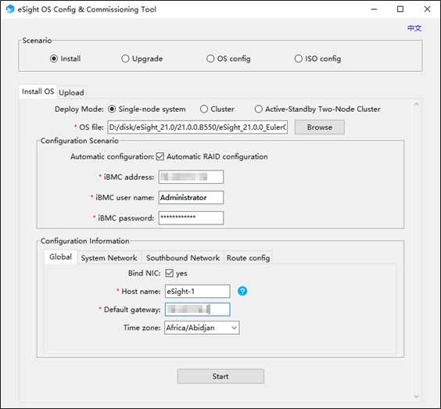
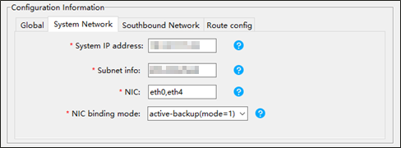
Installing and Configuring the Operating System
Run the eSight OS Config & Commissioning Tool.
Select the Install scenario.
Select the Single-node, Cluster or Active-Standby Two-Node Cluster deployment mode.
Enter information about the server iBMC management port.
Enter the network, time, and host name of the server service port.
The eSight configuration and commissioning tool can be used to install and configure the new operating system in an E2E manner as well as upload and deploy the eSight software.

Slide 17
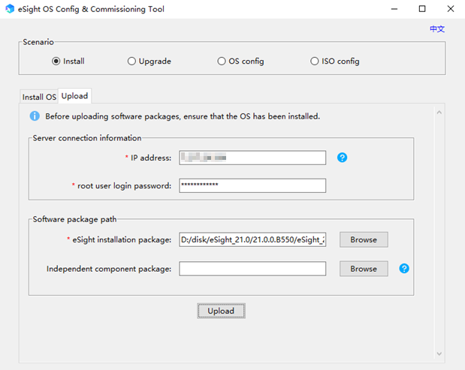
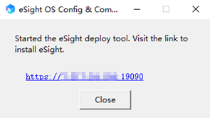
Uploading eSight Software Packages
Run the eSight OS Config & Commissioning Tool.
Select the Install scenario.
Click the Upload tab page.
If the message “Started the eSight deployment tool. Visit the link to install eSight” is displayed, click the link to go to the next step.

Slide 18
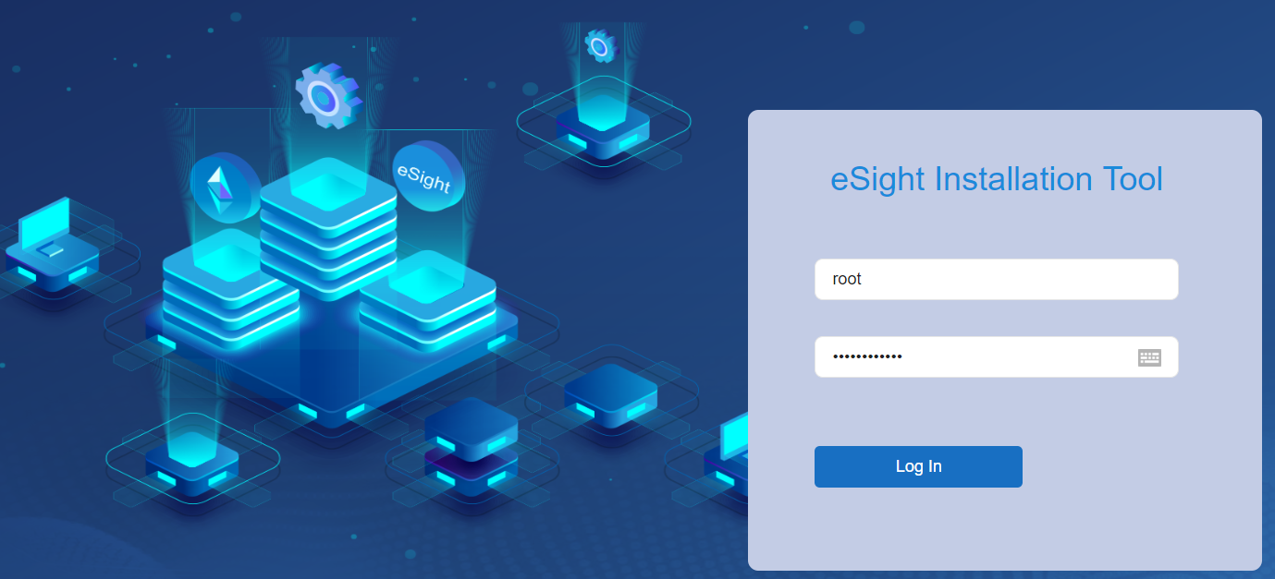
Installing eSight
Installing the eSight deployment tool
Upload the eSight deployment tool installation package to the server and start the eSight deployment tool.
Open a web browser, enter https://server system IP address:19090 in the address box, and press Enter. The login page of the eSight deployment tool is displayed.
Note: Log in to the deployment tool as the root user. The root user used for login is the root user of the server. The default password is Changeme_123.
eSight deployment tool login page

Slide 19
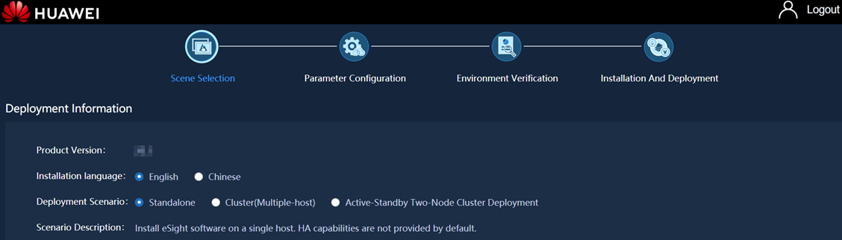
Installing eSight (Continued)
Select an installation language. The options are Chinese and English.
Select a deployment scenario. The options are Standalone, Cluster(Multiple-host), and Active-Standby Two-Node Cluster Deployment.
Configure the IP address and the operating system root user login password.

Slide 20
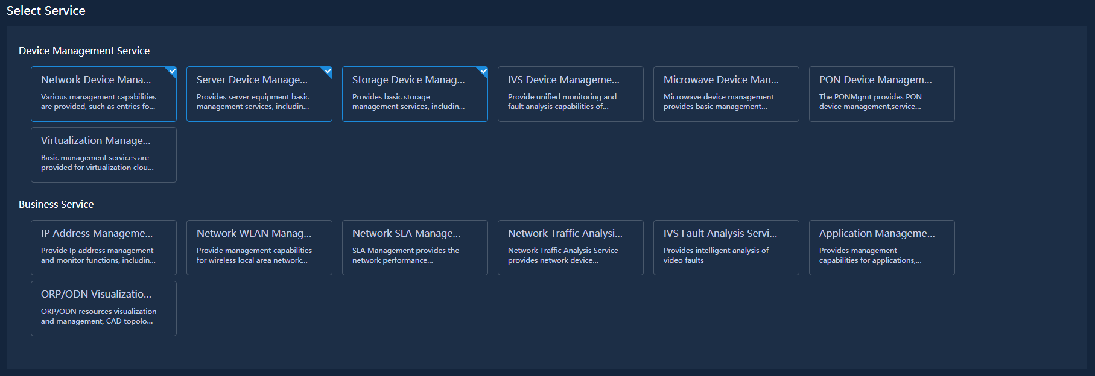
Installing eSight (Continued)
Select services to be installed based on the component plan.
If you install unnecessary services, the services cannot be uninstalled and will affect eSight operating efficiency. Therefore, you need to select required services correctly.

Slide 21
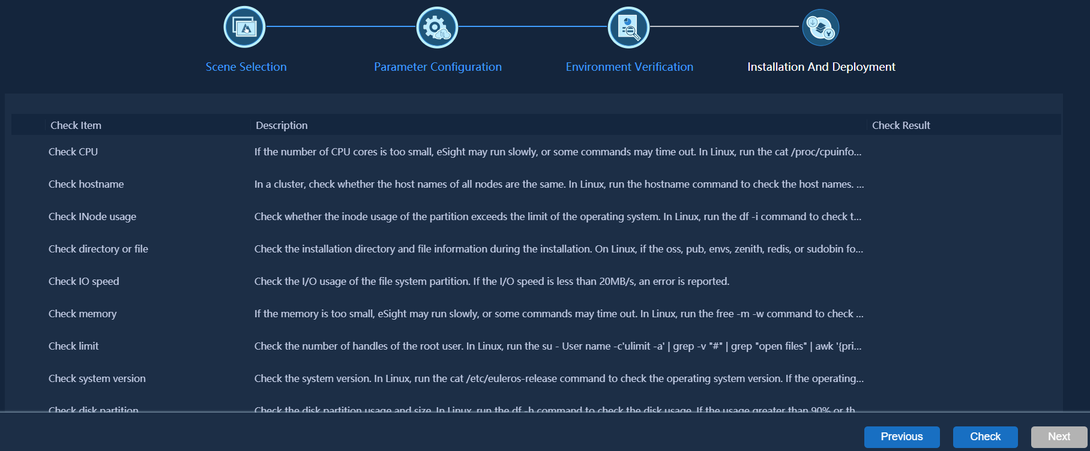
Installing eSight (Continued)
Click Check Item to check the environment.

Slide 22
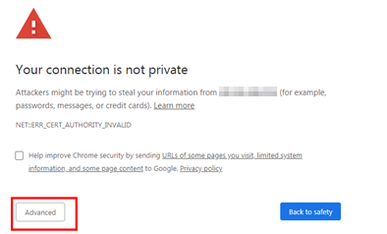
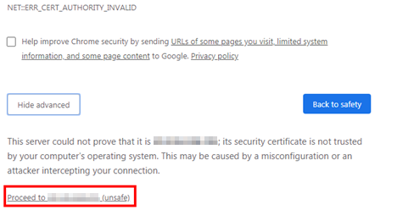
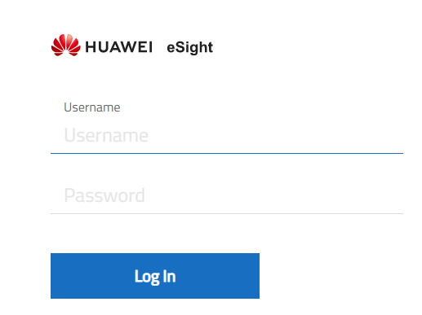
Logging In to the eSight Service Plane
Access https://NMS IP address:31943. A certificate error is displayed. Click Advanced.
On the Login page, enter a user name and password.
The initial password of the admin user is Changeme_123.

Slide 23
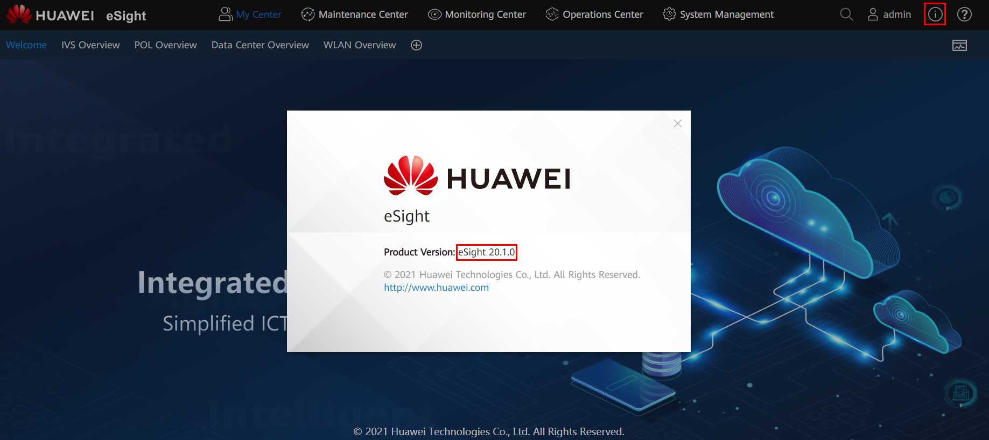

Viewing the eSight Version
Log in to eSight as an administrator and choose from the main menu.

Slide 24
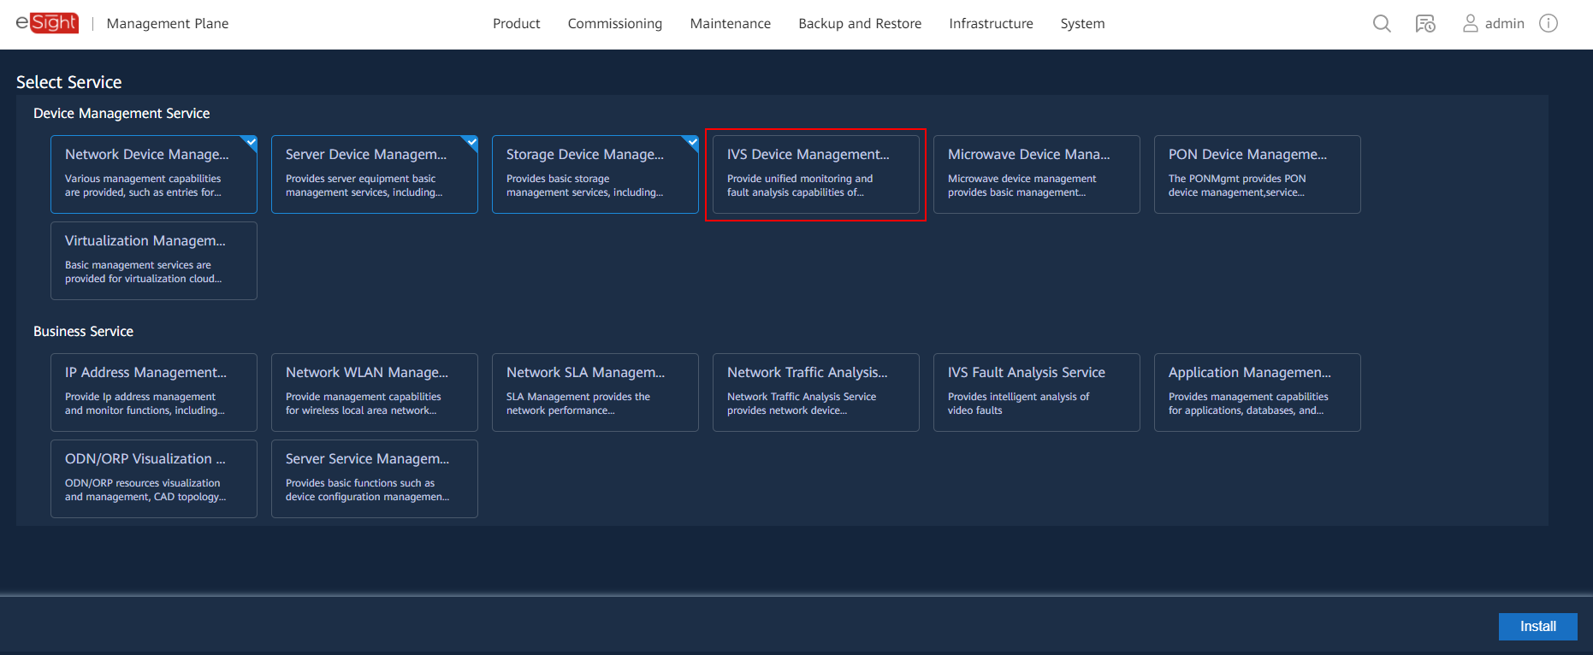
Incrementally Installing Service Components
On the management plane, choose Product > Engineering Deployment > Incremental Installation from the main menu and perform operations as prompted.

Slide 25
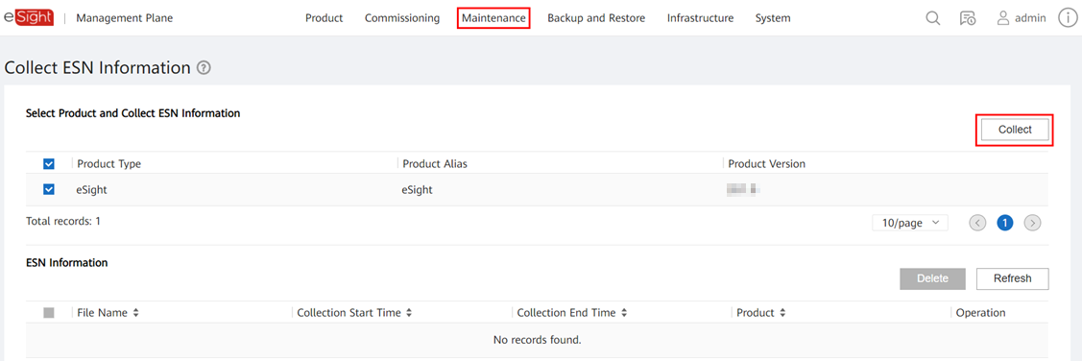
Loading a License File
On the management plane, choose Maintenance > Information Collection > Collect ESN Information from the main menu and perform operations as prompted.
For details, see the License User Guide.

Slide 26
1
eSight Deployment Solutions and Scenarios
2
eSight Installation and Commissioning
3
eSight O&M

Slide 27
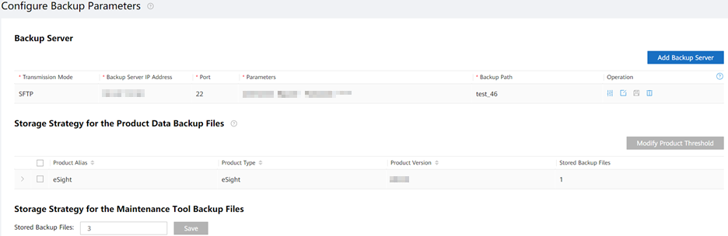
Backup and Restoration
To ensure the reliability of the management plane and O&M plane, back up the OS, application, and product data on a regular basis. If the management plane or service plane is faulty, you can restore the management plane or service plane to the state before backup by using the backup data.
Setting Global Backup Parameters
On the management plane, choose Backup and Restore > Configuration > Configure Backup Parameter from the main menu and set backup parameters as prompted.
Manual backup and scheduled backup
Select Back Up Product Data, Back Up Product Application, Back Up Database Application, and Back Up the Management Plane in sequence to manually back up data.
Choose Backup and Restore > Configuration > Configure Scheduled Backup Task from the management plane main menu.
Data restoration
Based on the fault scenario, choose Restore Product Data, Restore Product Application, Restore Database Application, or Restore the Management Plane to restore data. For details, see the product documentation.
Note: For details, see Operation and Maintenance > Maintenance Guide > Backup and Restore in the product documentation.

Slide 28
Configuring Network Information
If IP address conflict occurs on the network or the overall network plan changes (for example, an equipment room is relocated or a subnet mask is changed), change the IP address, subnet mask, and usage accordingly.
Set an IP address.
On the main menu of the management plane, choose Maintenance > Network Configuration > Configure IP Address and change the IP address based on the IP address plan.
Configure routes.
After obtaining the target network, network mask, and gateway of the route, choose Maintenance > Network Configuration > Configure Route from the main menu of the management plane to modify the route configurations.
Change the host name.
On the main menu of the management plane, choose Maintenance > Network Configuration > Modify Hostname and change the host name as prompted.
Note: For details, see Operation and Maintenance > Maintenance Guide > Configuring Network Information in the product documentation.

Slide 29
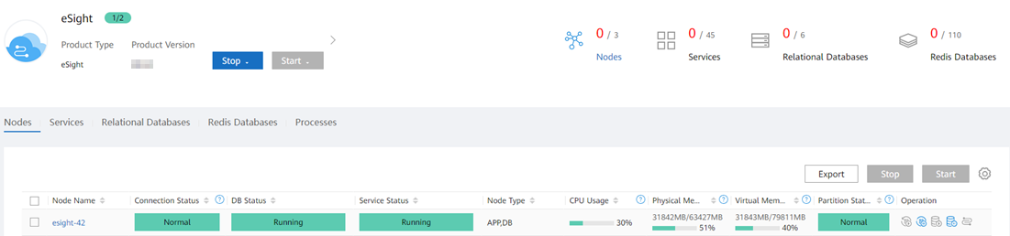
Starting or Stopping eSight
Startup and stop service plane:
a. Choose Product > System Monitor from the management plane main menu. The System Monitor page is displayed.
b. In the upper left corner of the System Monitor page, move the cursor to the corresponding product or Maintenance Tool, select it, and click Start or Stop.
Startup and stop management plane:
Log in to the management node and run the ipmc_adm -cmd {startmgr|stopmgr} command to start or stop the management plane.
Note: After eSight is installed using the deployment tool, eSight automatically starts. In the preinstallation scenario, eSight automatically starts upon server startup.

Slide 30
Uninstalling eSight
Log in to the primary management node of eSight as the sopuser user.
Switch to the root user.
# su - root
Run the following commands to uninstall eSight:
# cd /opt/engrTool/
# sh uninstall.sh (uninstallAll.sh for a cluster)
If the following information is displayed, eSight is uninstalled successfully:
uninstall successfully.
Note:
In the cluster scenario, log in to the server where the active eSight node is deployed.
To view the server IP address of the active node, perform the following operations:
Log in to the eSight management plane.
Click Product > System Monitor to display the maintenance tool page.
Click the node name in the first record to view the IP address of the server where the active node is deployed.

